Slide 1
PARMA: A Parallel Randomized Algorithm for Approximate Association Rules Mining in MapReduce
Date : 2013/10/16
Source : CIKM’12
Authors : Matteo Riondato, Justin A. DeBrabant, Rodrigo Fonseca, and Eli Upfa
Advisor : Dr.Jia-ling, Koh
Speaker : Wei, Chang

Slide 2
Outline
Introduction
Approach
Experiment
Conclusion

Slide 3
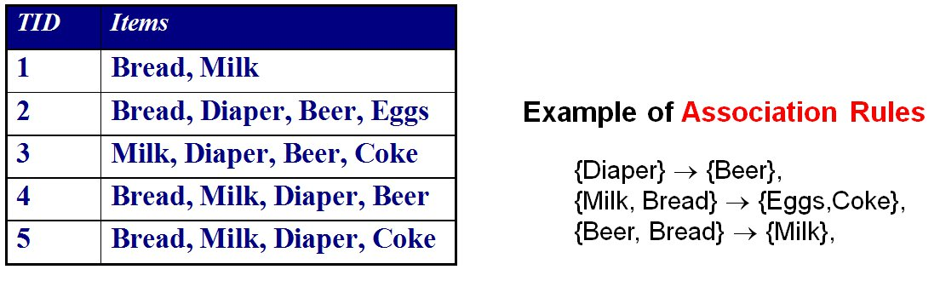
Association Rules
Market-Basket transactions

Slide 4
Itemset
I={Bread, Milk, Diaper, Beer, Eggs, Coke}
Itemsets
  1-itemsets: {Beer}, {Milk}, {Bread}, …
  2-itemsets: {Bread, Milk}, {Bread, Beer}, …
  3-itemsets: {Milk, Eggs, Coke}, {Bread, Milk, Diaper},…
t1 contains {Bread, Milk}, but doesn’t contain {Bread, Beer}

Slide 5
Frequent Itemset
Support count : σ(X)
  Frequency of occurrence of an itemset X
  σ(X) = |{t_{i} | X ⊆ t_{i} , t_{i} ∈T}|
  E.g. σ({Milk, Bread, Diaper}) = 2
Support
  Fraction of transactions that contain an itemset X
  s(X) = σ(X) /|T|
  E.g. s({Milk, Bread, Diaper}) = 2/5
Frequent Itemset
  An itemset X s(X) ≥ minsup

Slide 6
Association Rule
Association Rule
  X → Y, where X and Y are itemsets
  Example:
  {Milk, Diaper} → {Beer}
Rule Evaluation Metrics
  Support
    Fraction of transactions that contain both X and Y
    s(X→Y)= σ(X∪Y)/|T|
  Confidence
    How often items in Y appear in the transactions that contain X
    c(X→Y)= σ(X∪Y)/ σ(X)
Example:

Slide 7
Association Rule Mining Task
Given a set of transactions T, the goal of association rule mining is to find all rules having
  support ≥ minsup
  confidence ≥ minconf

Slide 8
Goal
Because :
  Number of transactions
  Cost of the existing algorithm, e.g. Apriori, FP-Tree
  What can we do in big data ?
    Sampling
    Parallel
Goal :
  A MapReduce algorithm for discovering approximate collections of frequent itemsets or association rules

Slide 9
Outline
Introduction
Approach
Experiment
Conclusion

Slide 10
Sampling
Original Data
Sampling
Find FI in Sample
Question : Is the sample always good ?

Slide 11
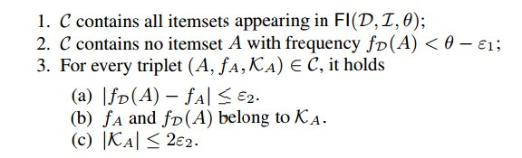




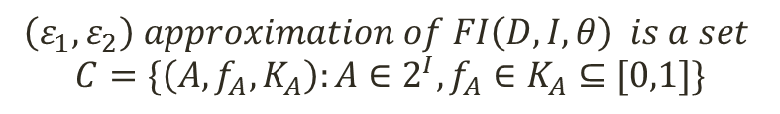

Definition
$$\left(ε_{1},ε_{2}\right) approximation of FI\left(D,I,θ\right) is a set$$
$$C=\{\left(A,f_{A},K_{A}\right):A∈2^{I}, f_{A}∈K_{A}⊆[0,1]\}$$
$$θ$$
$$ε_{1}$$
$$f_{A}$$
$$f_{D}(A)$$
$$ε_{2}$$

Slide 12
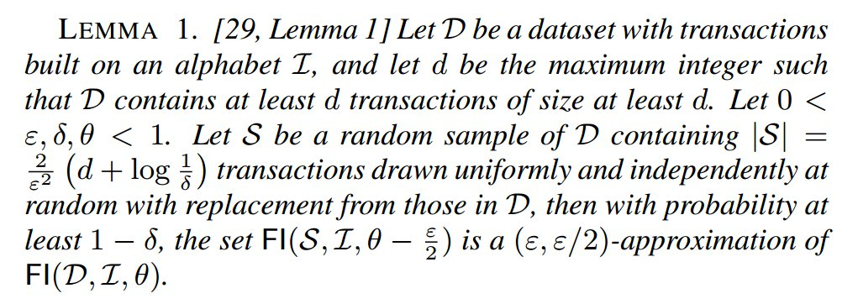
How many samples do we need?

Slide 13
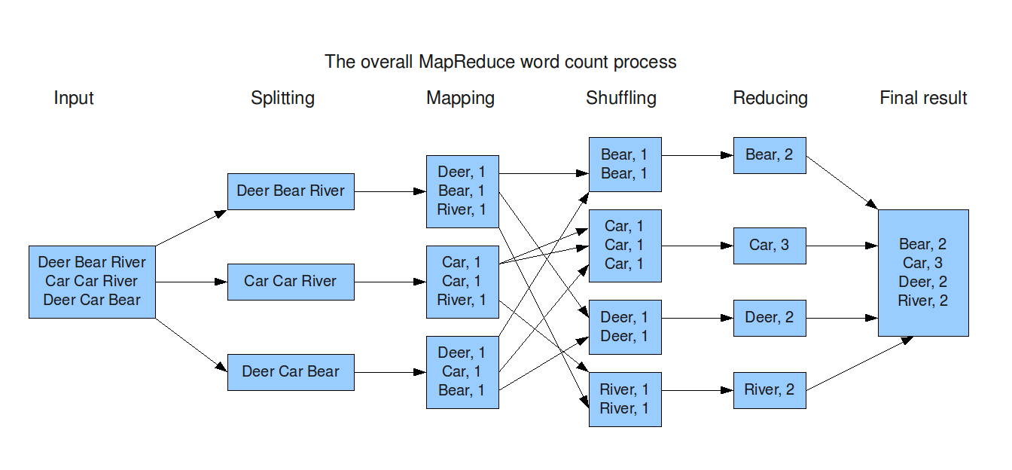
Introduction of MapReduce

Slide 14
Concept
Total Data
Sampling locally
Sampling locally
Sampling locally
Sampling locally
Sampling locally
Sampling locally
Mining
locally
Mining
locally
Mining
locally
Mining
locally
Mining
locally
Mining
locally
Global
Frequent Itemset

Slide 15
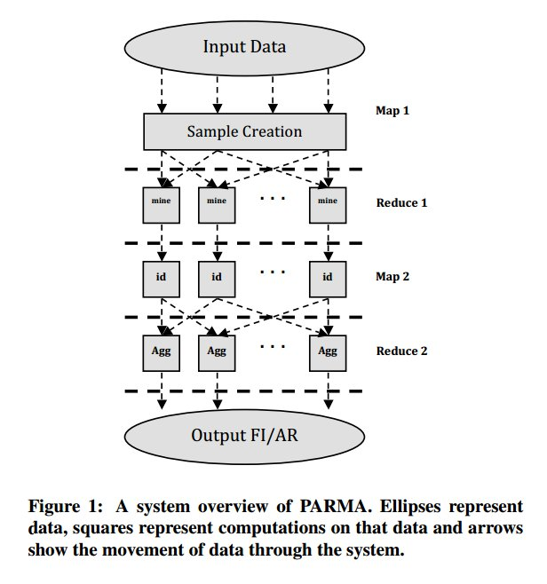
PARMA

Slide 16
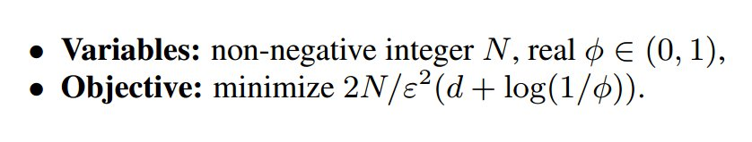
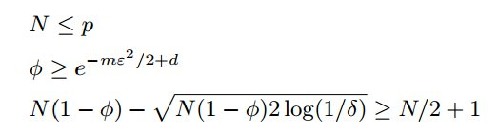
Trade-offs
Probability to get the wrong approximation
Number of samples

Slide 17



In Reduce 2
For each itemset, we have
Then we use
$$=$$

Slide 18



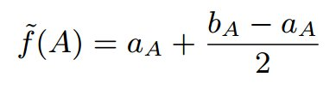


Result
The itemset A is declared globally frequent and will be present
in the output if and only if
Let be the shortest interval such that there are at least N-R+1 elements from that belong to this interval.

Slide 19
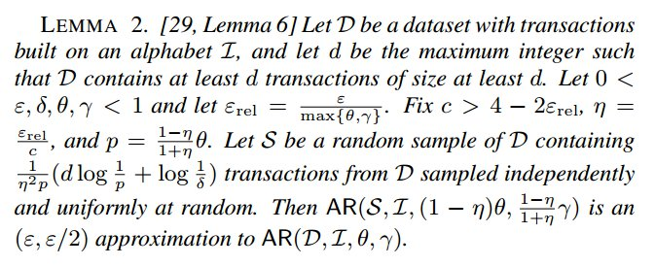
Association Rules

Slide 20
Outline
Introduction
Approach
Experiment
Conclusion

Slide 21

Implementation
Amazon Web Service : ml.xlarge
Hadoop with 8 nodes
Parameters :

Slide 22
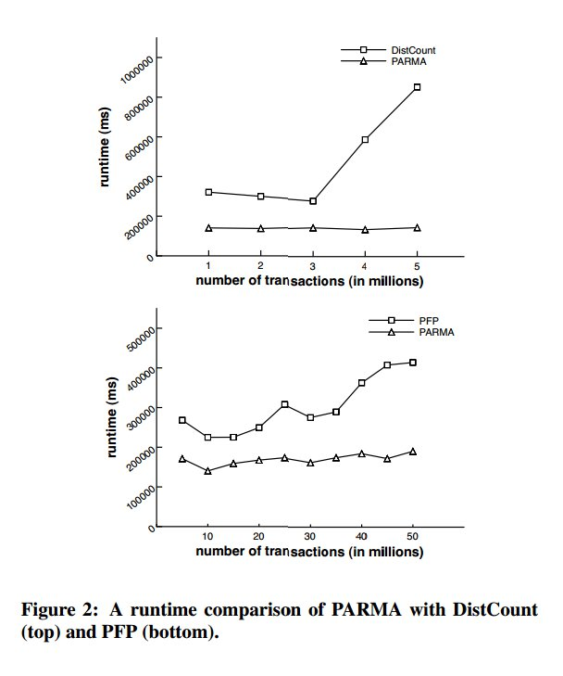
Compare with other Algorithm

Slide 23
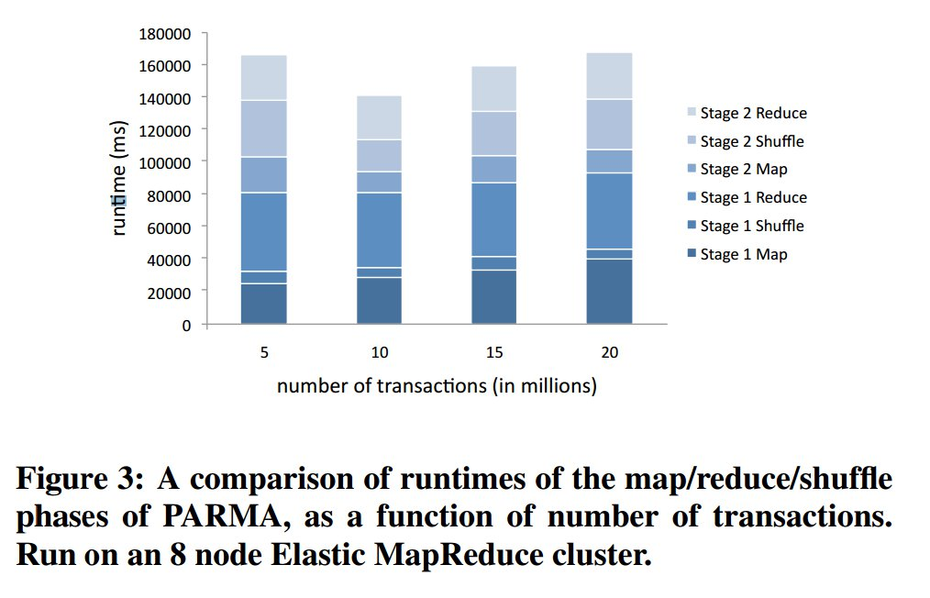
Runtime in Each Step

Slide 24
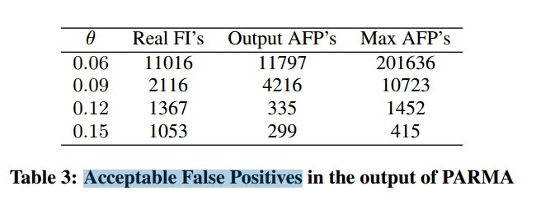
Acceptable False Positives

Slide 25
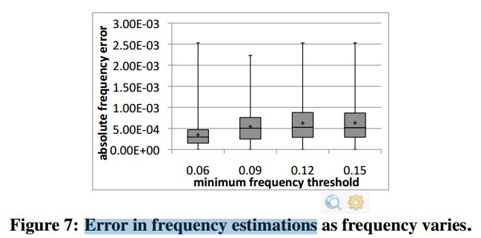
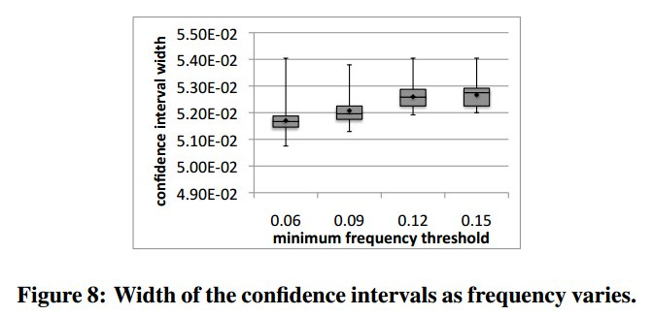
Error in frequency estimations

Slide 26
Outline
Introduction
Approach
Experiment
Conclusion

Slide 27
Conclusion
A parallel algorithm for mining quasi-optimal collections of frequent itemsets and association rules in MapReduce.
30-55% runtime improvement over PFP.
Verify the accuracy of the theoretical bounds, as well as show that in practice our results are orders of magnitude more accurate than is analytically guaranteed.

